Slide 1
Applied Data Science Project- SpaceX Falcon 9 launch
Author:-Divya Krishnakumar
Date:-12/04/2025

Slide 2
Table of Contents
SL No. | Title | Slide Number
1 | Executive Summary | 3
2 | Introduction | 4
3 | Methodology | 5
4 | Methodology (Data Collection and Data Wrangling) | 6-7
5 | EDA and interactive visual analytics methodology | 8-10
6 | Predictive analysis methodology | 11
7 | EDA with visualization results | 12-17
8 | EDA with SQL results | 18-25
9 | Folium results slides | 26-28
10 | Plotly Dashboard Results | 29-38
11 | Predictive Analysis Classification Results | 40-43
12 | Discussion Findings and Implications | 44
13 | Conclusion | 46
14 | Acknowledgement, Appendix and References | 47-48

Slide 3
Executive Summary
SpaceX advertises Falcon 9 launches with a cost of 69 million dollars with a view to reuse the first stage thereby saving much of the cost. If probability of success of first time launch is determined then the cost of launch can be determined. The aim of this project is to predict whether Falcon 9 first stage will launch successfully.
The dataset for this project is collected from "https://api.spacexdata.com/v4/launches/past" and filtered the data to include only Falcon 9 launches during data collection phase. There are different cases in the dataset where the booster landing was successful and unsuccessful. These cases are True Ocean, where booster was successfully landed in the ocean; False Ocean, where the landing mission outcome unsuccessfully landed to a specific region of the ocean; True RTLS, the mission outcome was successfully landed to a ground pad False RTLS means the mission outcome was unsuccessfully landed to a ground pad; True ASDS, means the mission outcome was successfully landed on a drone ship; False ASDS, means the mission outcome was unsuccessfully landed on a drone ship. Exploratory Data Analysis was performed in which missing values are replaced with mean of the given values. The landing outcome for each launch is determined. The data set was subjected to SQL queries for better understanding of the data. From this, the success rate of landing outcome was found to be 67%. The landing outcomes are converted into training labels.
Each launch aims to a dedicated orbit such as Low Earth Orbit(LEO), Very Low Earth Orbit(VLEO), Geosynchronous Orbit(GTO), Sun Synchronous Orbit(SSO), ELS-1, Highly Elliptical Orbit(HEO), ISS, MEO(Intermediate Circular Orbit), HEO (Geo Centric Orbits), GEO(Circular Geosynchronous Orbit), PO(Polar). The launch success rate may depend on many factors such as payload mass, orbit type etc. Data visualisation is performed to find success rate of each orbit type. The success rate may also depend on location and proximities of a launch site i.e. the initial position of rocket trajectories. Finding an optimal location for building a launch site certainly involves many factors. The success/failed launches for each site is marked on the map. A Dash application is created to visualize the success rates of each site. Then machine learning is implemented to predict the success rate of the launches. The accuracy score is determined to identify how much the predicted value deviates from the actual values.

Slide 4
Introduction
This project is for SpaceX which bids for 69 million dollars for a project in which first launch can be reused. The aim of this project is to predict the probability of success of first launch.
The key questions are:
What is the success rate of first launch?
What are the success rates of each Launch Site?
Which Booster Version has highest launch success rate?
Which orbits have more positive landing rate for different payloads?

Slide 5
Methodology
The dataset for this project is collected from api.spacex.com.
The methodology includes the following steps such as Data Collection; Exploratory Data Analysis-Data Wrangling, Data Visualisation; Data Modelling
The collected data is cleaned, analysed, generated labels for classification. The data is subjected to classification algorithms such as Logistic Regression, Support Vector Machine, Decision Tree Classifier, KNearestNeighbors.

Slide 6
Methodology (Data Collection and Data Wrangling)
Data Collection
The data is collected from https://api.spacexdata.com/v4/launches/past using a request- response API and converted into JSON format and then to a pandas dataframe. The columns of the dataframe are FlightNumber, Date, BoosterVersion, PayloadMass, Orbit, LaunchSite, Outcome, Flights, GridFins, Reused, Legs, LandingPad, Block, ReusedCount, Serial, Longitude, Latitude. Then the dataframe is filtered to obtain only Falcon 9 launches.
Data Wrangling
As a part of analysis missing values are replaced with mean. Then the number of launches of each site is determined. The number and occurrence of mission outcomes is calculated. The different landing outcomes are determined. Finally landing outcome label is created for each landing outcome.

Slide 7
Methodology (Data Collection and Data Wrangling)
The dataframe thus formed is the following. Here only first 5 rows of the dataframe is displayed.
 | FlightNumber | Date | BoosterVersion | PayloadMass | Orbit | LaunchSite | Outcome | Flights | GridFins | Reused | Legs | LandingPad | Block | ReusedCount | Serial | Longitude | Latitude | Class
0 | 1 | 04-06-2010 | Falcon 9 | 6104.95941 | LEO | CCAFS SLC 40 | None None | 1 | FALSE | FALSE | FALSE | NaN | 1 | 0 | B0003 | -80.577366 | 28.561857 | 0
1 | 2 | 22-05-2012 | Falcon 9 | 525 | LEO | CCAFS SLC 40 | None None | 1 | FALSE | FALSE | FALSE | NaN | 1 | 0 | B0005 | -80.577366 | 28.561857 | 0
2 | 3 | 01-03-2013 | Falcon 9 | 677 | ISS | CCAFS SLC 40 | None None | 1 | FALSE | FALSE | FALSE | NaN | 1 | 0 | B0007 | -80.577366 | 28.561857 | 0
3 | 4 | 29-09-2013 | Falcon 9 | 500 | PO | VAFB SLC 4E | False Ocean | 1 | FALSE | FALSE | FALSE | NaN | 1 | 0 | B1003 | -120.610829 | 34.632093 | 0
4 | 5 | 03-12-2013 | Falcon 9 | 3170 | GTO | CCAFS SLC 40 | None None | 1 | FALSE | FALSE | FALSE | NaN | 1 | 0 | B1004 | -80.577366 | 28.561857 | 0

Slide 8
EDA and interactive visual analytics methodology
Data Analysis
As a part of analysis missing values are replaced with mean. Then the number of launches of each site is determined. The number and occurrence of mission outcomes is calculated. The different landing outcomes are determined. Finally landing outcome label is created for each landing outcome.

Slide 9
EDA and interactive visual analytics methodology
Data Visualization methodology
A cat plot is drawn showing relation ship between flight number and launch site.
A scatter plot is drawn to show relationship between payload and launch site. From this the finding is that or the VAFB-SLC launch site there are no rockets launched for heavy payload mass(greater than 10000).
A bar chart is created to show relationship between success rate and orbit type.
A scatter plot is created to show relationship between Flight Number and orbit type.

Slide 10
EDA and interactive visual analytics methodology
A scatter plot is created to show relationship between payload and orbit type
A line plot is created to show the success yearly trend.
A folium map is created and marked the launch sites and successful and unsuccessful launches.
A Dash application is created to visualize the success rate of each launch site and booster version of different payloads.

Slide 11
Predictive analysis methodology
The data is subjected to classification algorithms such as Logistic Regression, Support Vector Machine, Decision Tree Classifier, KNearestNeighbors.
It answers the question - what is likely to happen?
It predicts the outcome which is the probability of success first launch.

Slide 12
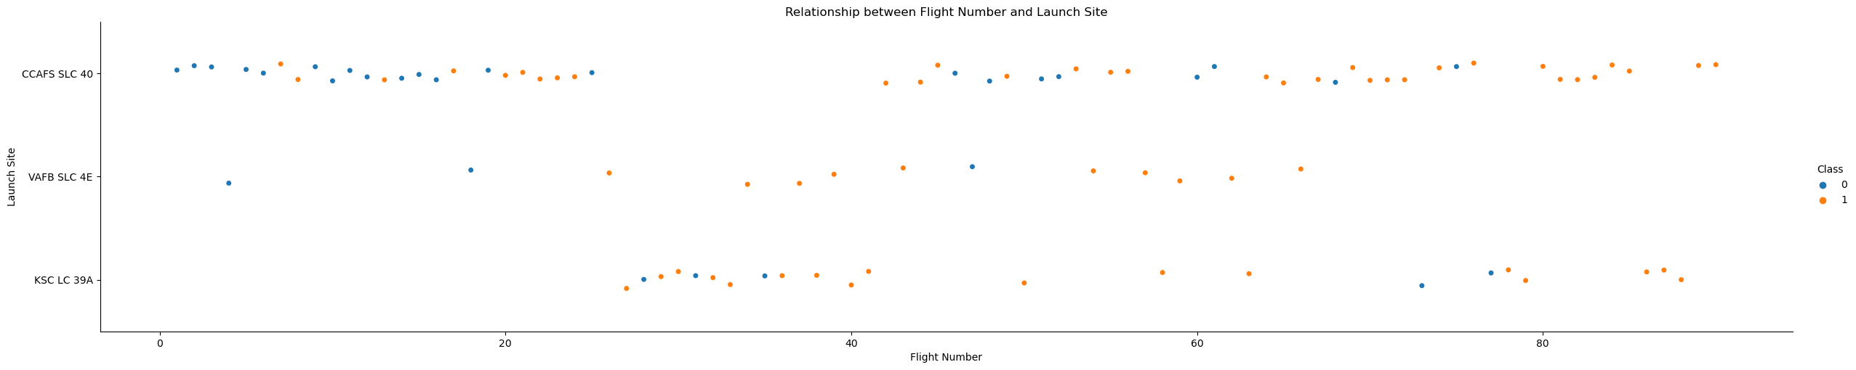
EDA with visualization results
Relation ship between flight number and launch site

Slide 13
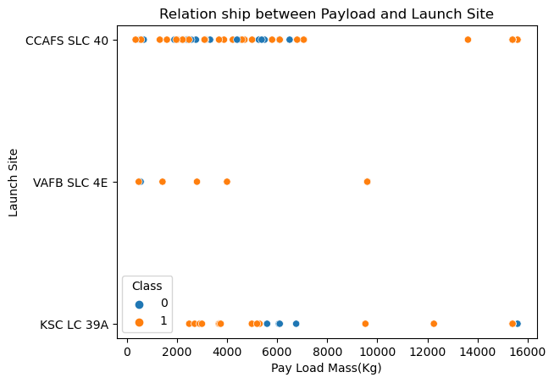
EDA with visualization results
Data Visualisation
A scatter plot is drawn to show relationship between payload and launch site.

Slide 14
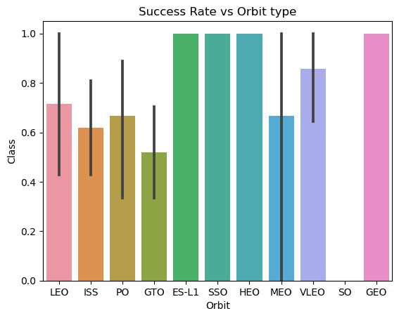
EDA with visualization results
Relationship between success rate of each orbit type

Slide 15
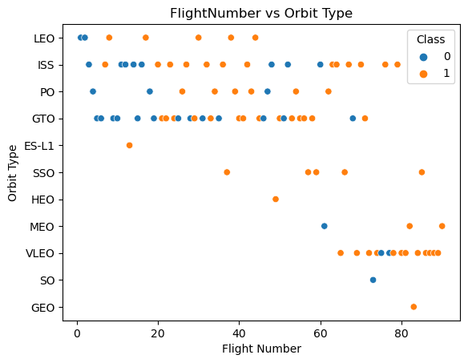
EDA with visualization results
Relationship between FlightNumber and Orbit type

Slide 16
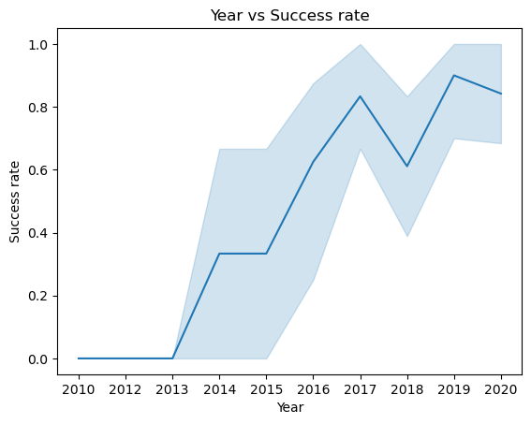
EDA with visualization results
The success rate since 2013 kept increasing till 2017 (stable in 2014) and after 2015 it started increasing. Visualised the launch success yearly trend.

Slide 17
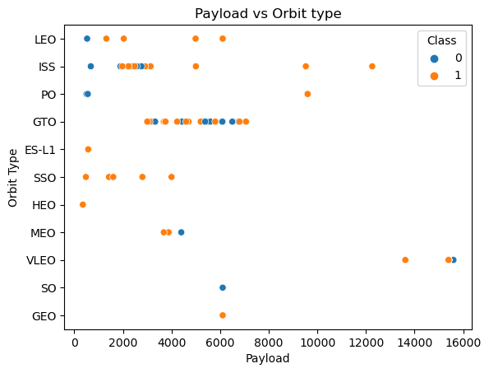
EDA with visualization results
With heavy payloads the successful landing or positive landing rate are more for Polar, LEO and ISS. However, for GTO we cannot distinguish this well as both positive landing rate and negative landing(unsuccessful mission) are both there here.

Slide 18
EDA with SQL results
Display the names of the unique launch sites in the space mission
Launch_Site
CCAFS LC-40
VAFB SLC-4E
KSC LC-39A
CCAFS SLC-40

Slide 19
EDA with SQL results
Display 5 records where launch sites begin with the string 'CCA'
Date | Time (UTC) | Booster_Version | Launch_Site | Payload | PAYLOAD_MASS__KG_ | Orbit | Customer | Mission_Outcome | Landing_Outcome
04-06-2010 | 18:45:00 | F9 v1.0 B0003 | CCAFS LC-40 | Dragon Spacecraft Qualification Unit | 0 | LEO | SpaceX | Success | Failure (parachute)
08-12-2010 | 15:43:00 | F9 v1.0 B0004 | CCAFS LC-40 | Dragon demo flight C1, two CubeSats, barrel of Brouere cheese | 0 | LEO (ISS) | NASA (COTS) NRO | Success | Failure (parachute)
22-05-2012 | 07:44:00 | F9 v1.0 B0005 | CCAFS LC-40 | Dragon demo flight C2 | 525 | LEO (ISS) | NASA (COTS) | Success | No attempt
08-10-2012 | 00:35:00 | F9 v1.0 B0006 | CCAFS LC-40 | SpaceX CRS-1 | 500 | LEO (ISS) | NASA (CRS) | Success | No attempt
01-03-2013 | 15:10:00 | F9 v1.0 B0007 | CCAFS LC-40 | SpaceX CRS-2 | 677 | LEO (ISS) | NASA (CRS) | Success | No attempt

Slide 20
EDA with SQL results
Display the total payload mass carried by boosters launched by NASA (CRS)
Total payload mass
45596
Display average payload mass carried by booster version F9 v1.1
Average payload mass in kg
2534.66667

Slide 21
EDA with SQL results
List the date when the first succesful landing outcome in ground pad was achieved.
Date
22-12-2015
List the names of the boosters which have success in drone ship and have payload mass greater than 4000 but less than 6000
Booster_Version
F9 FT B1022
F9 FT B1026
F9 FT B1021.2
F9 FT B1031.2

Slide 22
EDA with SQL results
List the total number of successful and failure mission outcomes
Mission Outcome | Number of outcomes
Failure (in flight) | 1
Success | 98
Success | 1
Success (payload status unclear) | 1

Slide 23
EDA with SQL results
List all the booster versions that have carried the maximum payload mass. Use a subquery.
Booster_Version
F9 B5 B1048.4
F9 B5 B1049.4
F9 B5 B1051.3
F9 B5 B1056.4
F9 B5 B1048.5
F9 B5 B1051.4
F9 B5 B1049.5
F9 B5 B1060.2
F9 B5 B1058.3
F9 B5 B1051.6
F9 B5 B1060.3
F9 B5 B1049.7

Slide 24
EDA with SQL results
List the records which will display the month names, failure landing outcomes in drone ship ,booster versions, launch_site for the months in year 2015.
Month | Failure | Booster_Version | Launch_Site
1 | None | F9 v1.1 B1012 | CCAFS LC-40
2 | None | F9 v1.1 B1013 | CCAFS LC-40
3 | None | F9 v1.1 B1014 | CCAFS LC-40
4 | None | F9 v1.1 B1015 | CCAFS LC-40
4 | None | F9 v1.1 B1016 | CCAFS LC-40
6 | None | F9 v1.1 B1018 | CCAFS LC-40
12 | None | F9 FT B1019 | CCAFS LC-40

Slide 25
EDA with SQL results
Rank the count of landing outcomes (such as Failure (drone ship) or Success (ground pad)) between the date 2010-06-04 and 2017-03-20, in descending order.
Landing_Outcome | Number_of_Landing_outcomes
Uncontrolled (ocean) | 2
Success (ground pad) | 3
Success (drone ship) | 5
Precluded (drone ship) | 1
No attempt | 10
Failure (parachute) | 1
Failure (drone ship) | 5
Controlled (ocean) | 3

Slide 26
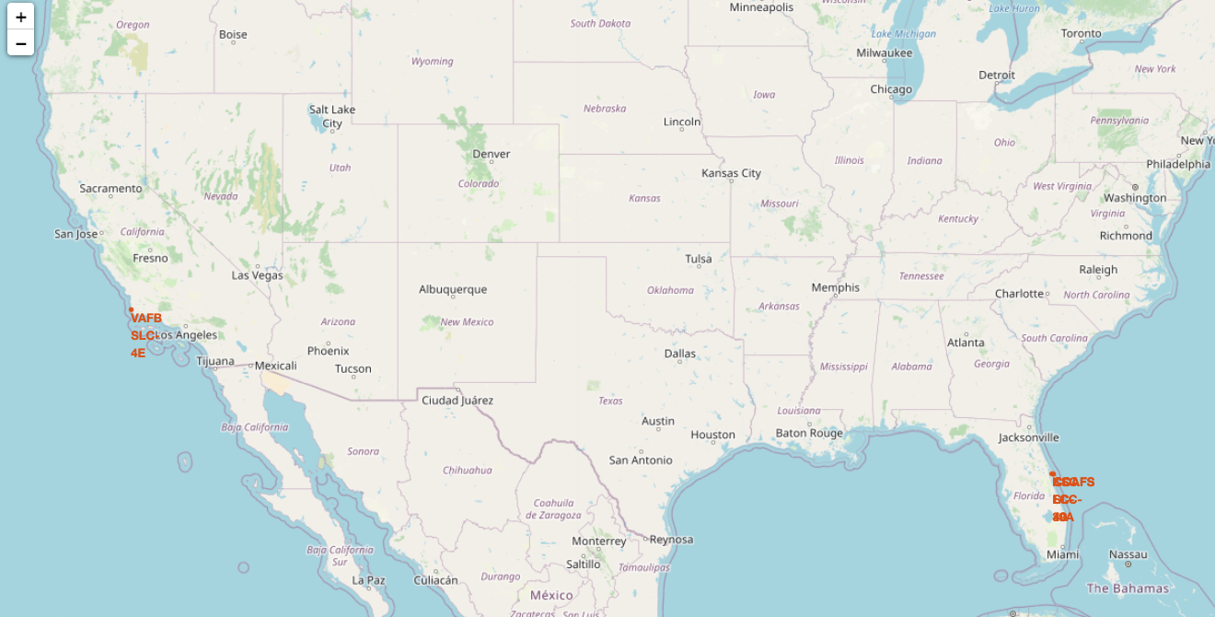
Folium results slides
Mark all launch sites on a map

Slide 27
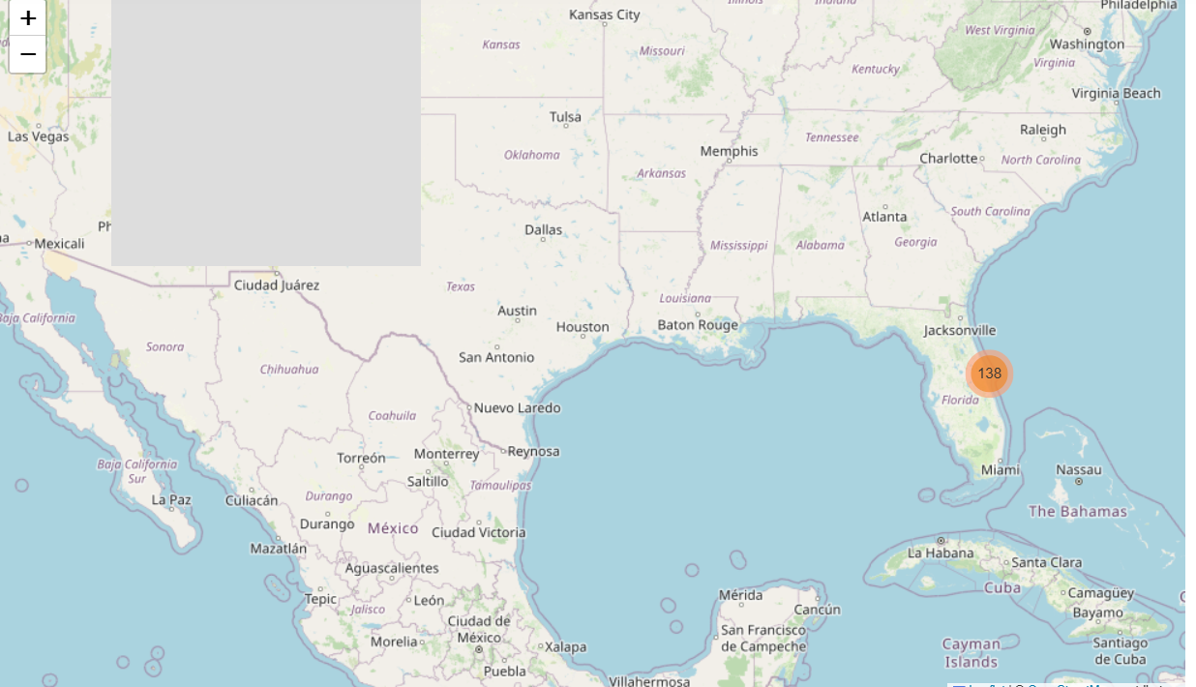
Folium results slides
Mark the success/failed launches for each site on the map

Slide 28
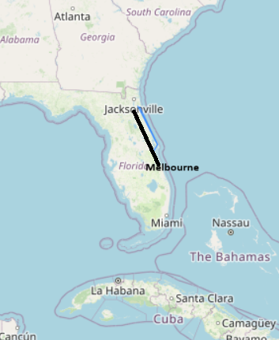
Folium results slides
Calculate the distances between a launch site to its proximities

Slide 29
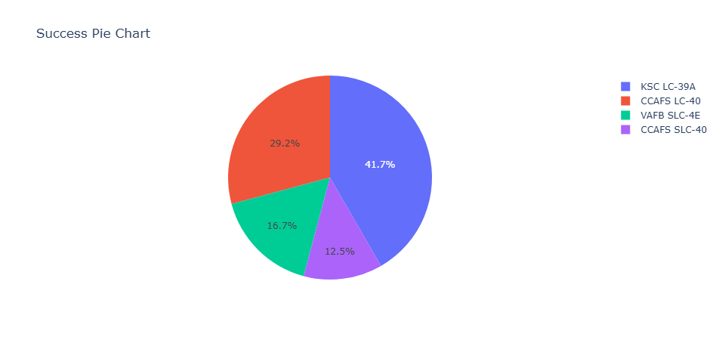
Plotly Dashboard Results
A Dash application was developed to visualize the success rates of each site The pie chart for all success of all launch sites is shown below
.

Slide 30
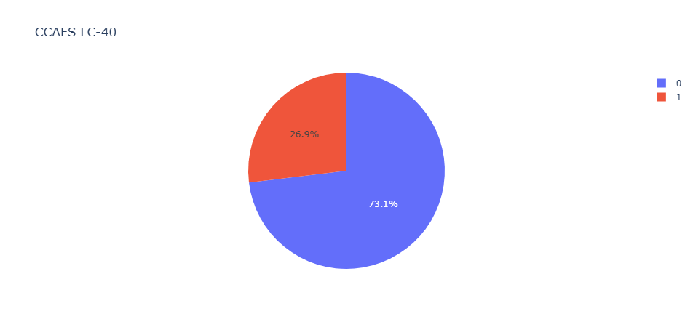
Plotly Dashboard Results
The pie chart for success launch of site CCAFS LC-40

Slide 31
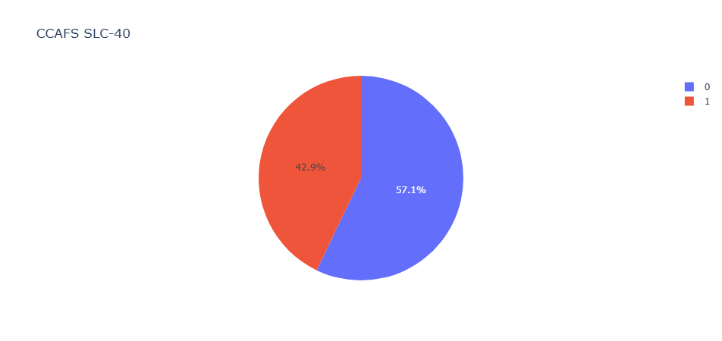
Plotly Dashboard Results
The pie chart for success launch of site CCAFS SLC-40

Slide 32
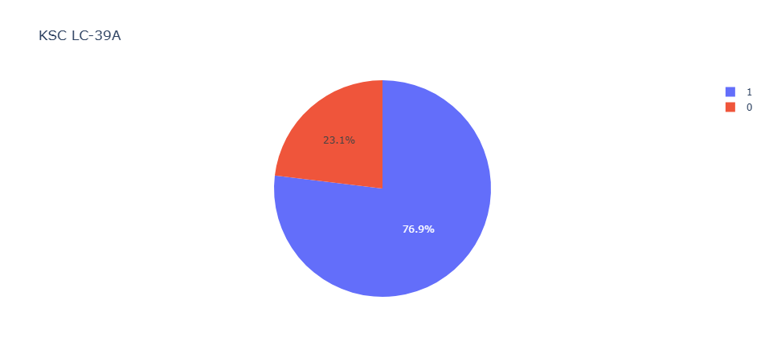
Plotly Dashboard Results
The pie chart for success launch of site KSC-LC 39A

Slide 33
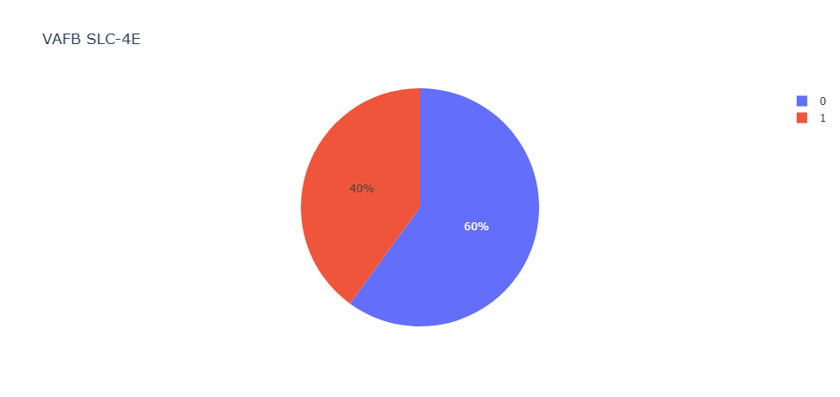
Plotly Dashboard Results
The pie chart for success launch of site VAFB SLC-4E

Slide 34
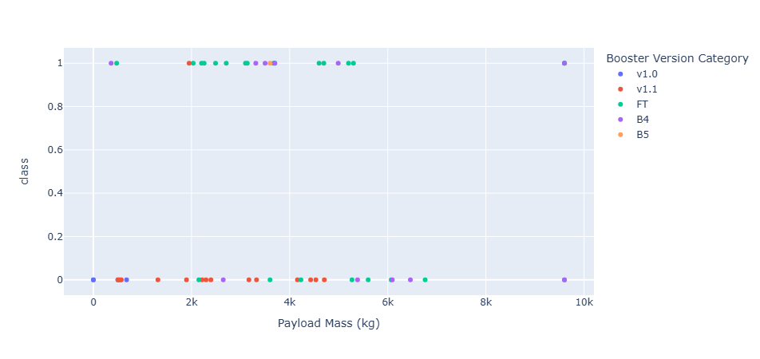
Plotly Dashboard Results
The scatter plot for all launch sites

Slide 35
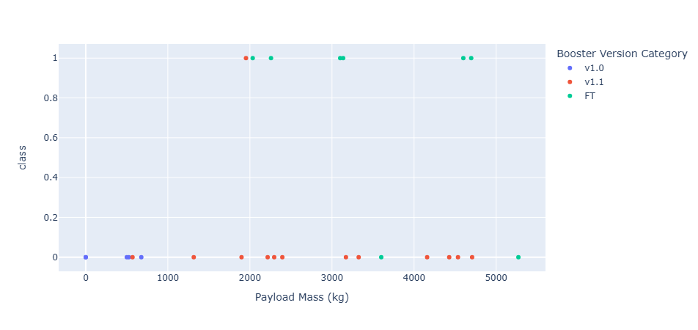
Plotly Dashboard Results
The scatter chart for success launch of site CCAFS LC-40

Slide 36
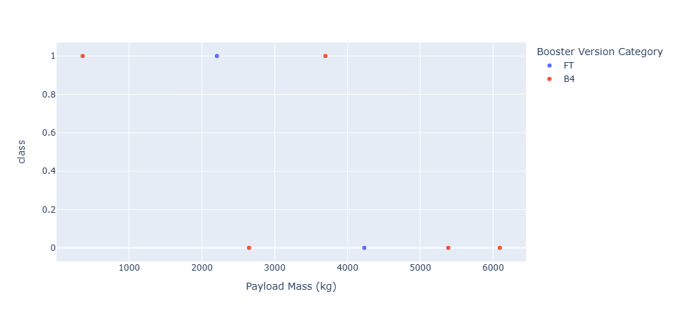
Plotly Dashboard Results
The scatter chart for success launch of site CCAFS SLC-40

Slide 37
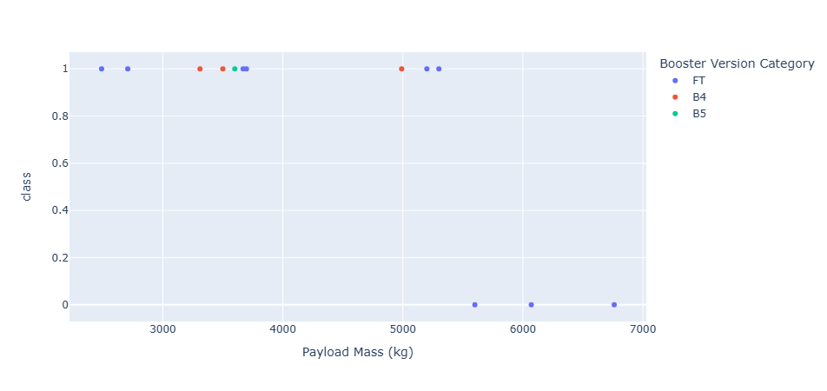
Plotly Dashboard Results
The scatter chart for success launch of site KSC LC-39A

Slide 38
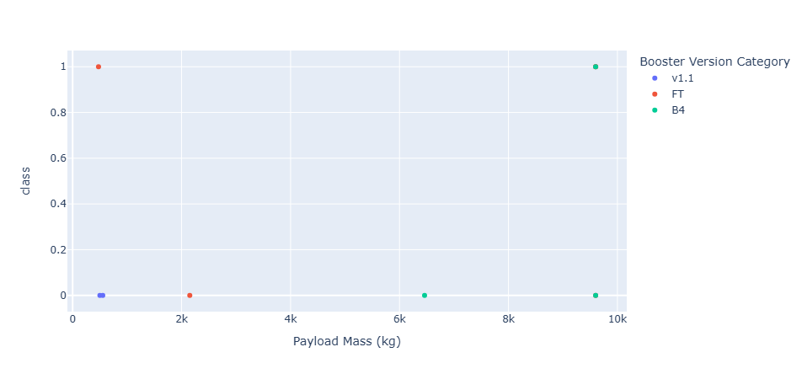
Plotly Dashboard Results
The scatter chart for success launch of site VAFB SLC-4E

Slide 39
Predictive Analysis Classification Results
Data Modelling
The data set is subjected to machine learning pipeline after feature engineering. The machine learning models of Logistic Regression, Support Vector Machine and Decision Tree Classifier and KNearestNeighbors are created and fitted on the training data. The results are predicted for each model.

Slide 40
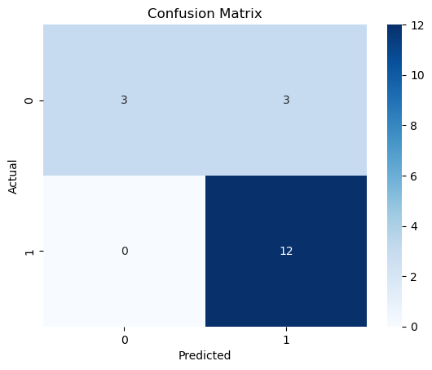
Predictive Analysis Classification Results
Logistic Regression
tuned hpyerparameters :(best parameters) {'C': 0.01, 'penalty': 'l2', 'solver': 'lbfgs'} accuracy : 0.8464285714285713
Accuracy Score of logistic regression is 0.8333333333333334

Slide 41
Predictive Analysis Classification Results
Support vector machine
tuned hpyerparameters :(best parameters) {'C': 1.0, 'gamma': 0.03162277660168379, 'kernel': 'sigmoid'} accuracy : 0.8482142857142856
Accuracy score 0.8333333333333334

Slide 42
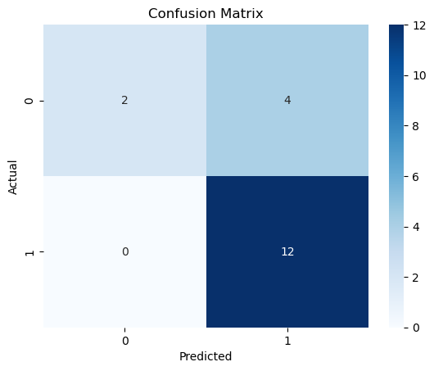
Predictive Analysis Classification Results
Decision Tree Classifier
Accuracy score of decision tree is 0.87 on test data.
tuned hpyerparameters :(best parameters) {'criterion': 'entropy', 'max_depth': 4, 'max_features': 'auto', 'min_samples_leaf': 4, 'min_samples_split': 2, 'splitter': 'random'} accuracy : 0.8875000000000002

Slide 43
Predictive Analysis Classification Results
K Nearest neighbours
tuned hpyerparameters :(best parameters) {'algorithm': 'auto', 'n_neighbors': 10, 'p': 1} accuracy : 0.8482142857142858
Accuracy score of KNearestNeighbors is 0.8333333333333334

Slide 44
Discussion Findings and Implications
The success rates of launch site KSC LC-39 A is 47.1%.
The success rate of launch site CCAFS LC-40 is 29.2%.
The success rate of launch site VAFB SLC-4E is 16.7%.
The success rate of launch site CCAFS SLC-40 is 12.5%.
From this it is evident that KSC LC-39A has highest success rate and CCAFS SLC-40 has least success rate.
The successful launches of KSC LC-39A when compared to unsuccessful launches is 76.9%.
FT booster version has highest launch success rate followed by B4.

Slide 45
Discussion Findings and Implications
The success rates are high for payload of 2000 to 6000.
The logistic regression, Support Vector machine and KNearestNeighbors showed an accuracy score of 83% on the test data.
The decision tree showed an accuracy score of 87% on test data.
This means that the probability of successful first launch is 83% to 87%.

Slide 46
Conclusion
The total number of success outcomes is found to be high. The success rate is increasing since 2015. With heavy payloads the successful landing or positive landing rate are more for Polar, LEO and ISS. The success rate of KSC LC-39A is the highest. FT booster version has the highest success launch rate.
From the above findings the probability of successful launch is very high. All the unsuccessful launches are preplanned. Thus, we can conclude that first launch will be successful.

Slide 47
Acknowledgement
I here by acknowledge my sincere gratitude towards the entire IBM Skills Network team and Course era to complete my project successfully in due time. I thank every one who provided all resources in completion of this project. I thank the authors of the project especially Prof. Joseph Santarcangelo to provide guidance and resources for the project.

Slide 48
Appendix and References
https://api.spacexdata.com/v4/launches/past
Reading: Structure Of A Report | Coursera
Data Collection Overview | Coursera
Applied Data Science Capstone-IBM

